Slide 1


Project Title - Seasonal Agriculture Performance Analysis
Student Name -Chandrika Katam
College Name- Shri vishnu engineering college for women
AICTE STU ID : STU69dc74483ad151776055368
9/3/2026
Annual Review
‹#›

Slide 2

PROBLEM STATEMENT
  Agricultural performance changes from season to season because of differences in environmental conditions, farming practices, resource availability and market conditions.
  The main challenge is to analyze the agricultural dataset and understand how performance changes across seasons by identifying important patterns, trends, relationships and variations.
9/3/2026
Annual Review
‹#›

Slide 3

Project Description
  Seasonal Agriculture Performance Analysis is a data analysis project that studies agricultural performance across Kharif, Rabi and Zaid seasons.
  The project involves cleaning the agricultural dataset, exploring important variables and comparing yield, profit, resource usage and environmental conditions across seasons.
  Data visualization and statistical analysis are used to identify useful patterns and relationships that can help in better agricultural planning
9/3/2026
Annual Review
‹#›

Slide 4


WHO ARE THE END USERS?
  Farmers – to understand seasonal crop performance.
  Agricultural planners – to support better seasonal planning.
  Government departments – to understand agricultural trends.
  Agricultural analysts – to study relationships between different factors.
  Researchers/Students – for agricultural data analysis and research.
9/3/2026
Annual Review
‹#›

Slide 5


Technology Used
  Python – Data cleaning and analysis
  Pandas – Data manipulation
  NumPy – Numerical calculations
  Matplotlib – Data visualization
  Seaborn – Statistical visualizations
  SciPy – Statistical analysis
  Google Colab – Jupyter Notebook environment
  GitHub – Project/code storage
9/3/2026
Annual Review
‹#›
Notes:
5

Slide 6
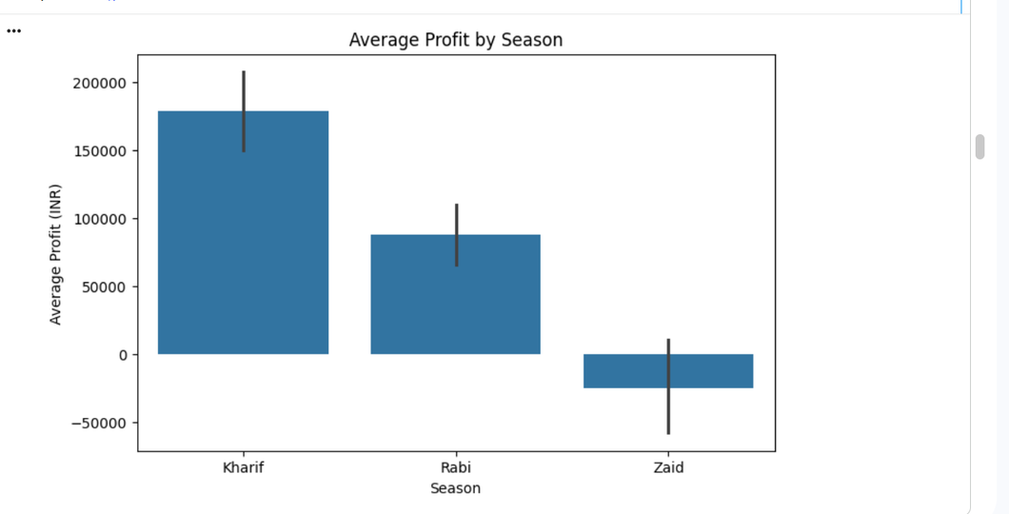
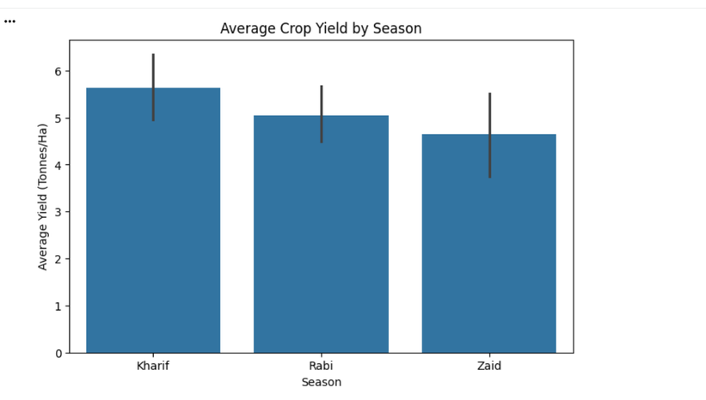
RESULTS
Kharif also has the highest average profit, while Zaid shows comparatively poor profitability. This shows that seasonal performance differs economically as well.
Kharif shows the highest average crop yield, followed by Rabi and Zaid. This shows that yield performance varies across seasons.
9/3/2026
Annual Review
‹#›

Slide 7
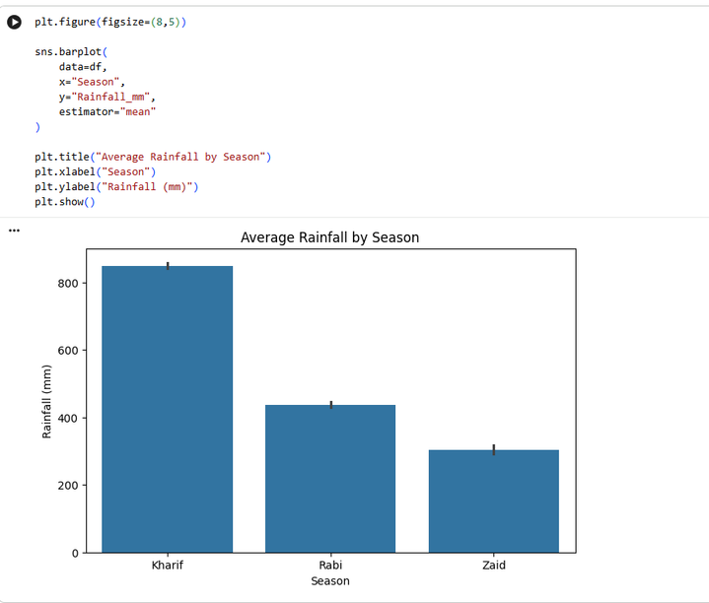
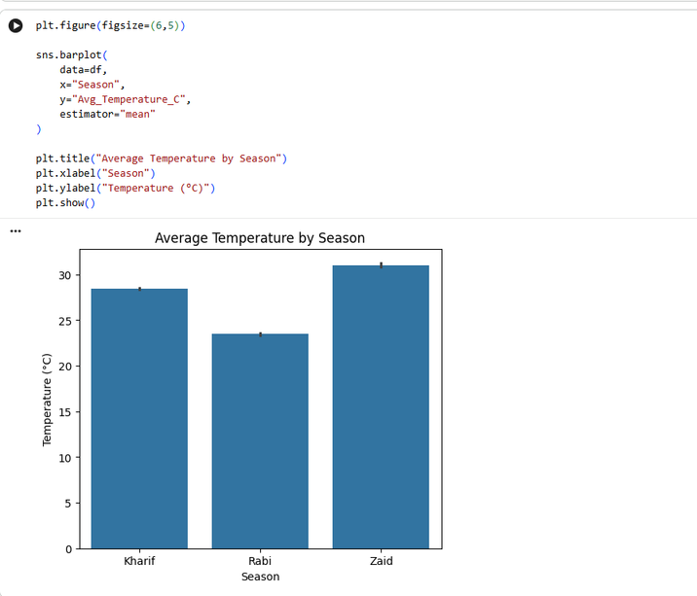
RESULTS
Rainfall varies clearly across the seasons, with Kharif receiving the highest average rainfall.
Temperature also differs across seasons, with Zaid showing the highest average temperature and Rabi the lowest.
9/3/2026
Annual Review
‹#›

Slide 8
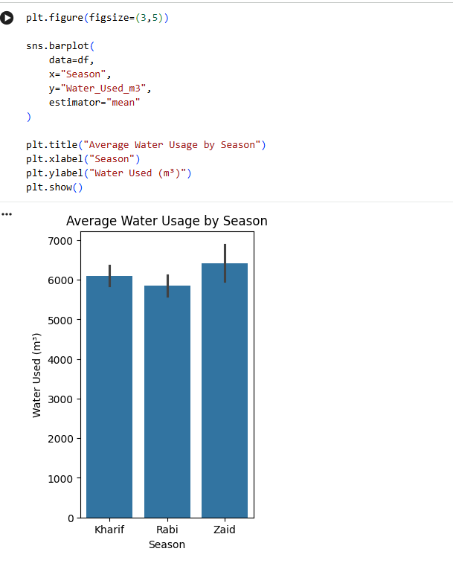
RESULTS
Water usage differs across seasons, with Zaid showing the highest average water consumption.
9/3/2026
Annual Review
‹#›

Slide 9
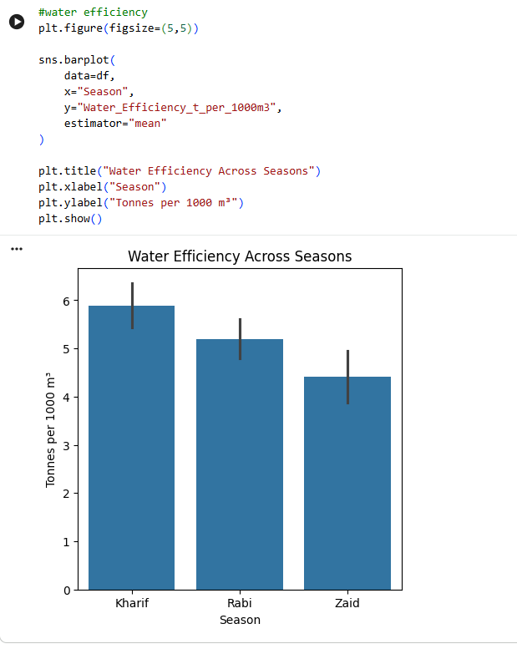
RESULTS
Despite higher water usage, Zaid has lower water efficiency, while Kharif performs better in terms of efficiency.
9/3/2026
Annual Review
‹#›

Slide 10
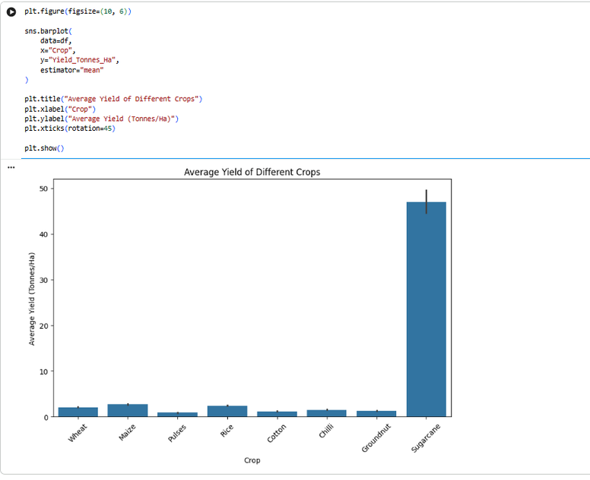
RESULTS
The graph shows that average yield is different for different crops. Some crops have higher yields than others, showing that crop type also affects agricultural performance.
9/3/2026
Annual Review
‹#›

Slide 11
Future scope
In the future, the project can be extended by:
  Adding real-time weather data.
  Using larger and more recent agricultural datasets.
  Building machine learning models to predict crop yield.
  Developing crop recommendation systems.
  Creating an interactive dashboard for farmers and agricultural planners.
  Providing region-specific agricultural recommendations.
9/3/2026
Annual Review
‹#›

Slide 12
GitHub Link
https://github.com/chandrika-k137/seasonal-agriculture-performance-analysis.git
9/3/2026
Annual Review
‹#›

Slide 13

VOIS Course completion certificate -
Course name- Data Visualization
9/3/2026
Annual Review
‹#›

Slide 14
Thank you
.
.
from:
CHANDRIKA KATAM
Shri vishnu engeering college for women-Bhimavaam
9/3/2026
Annual Review
‹#›

